Slide 1
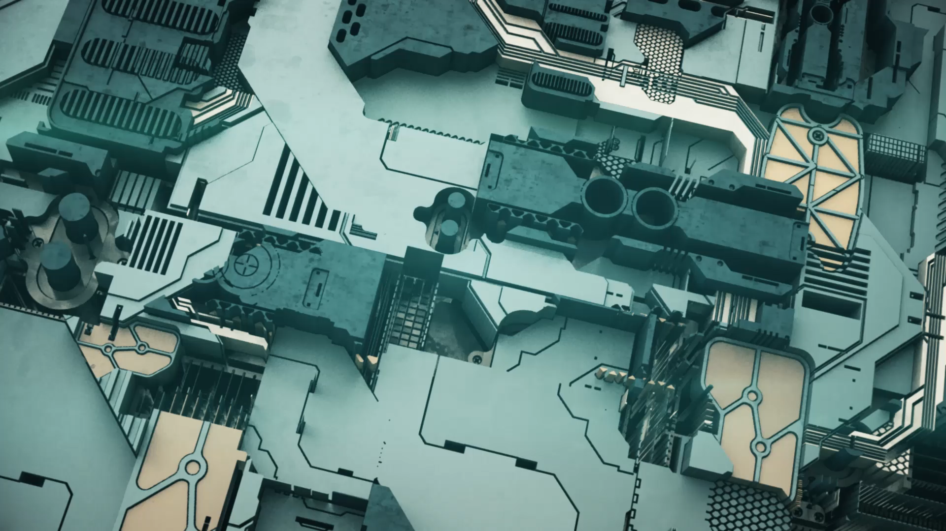
CLAMPERS
BY: SANDESH & SUMEET

Slide 2
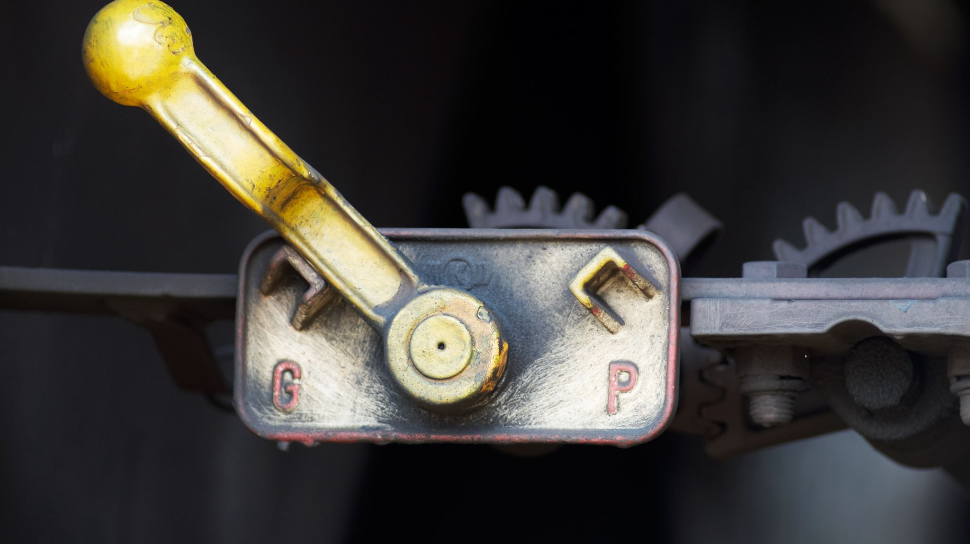
Introduction to Clampers
Clamper circuits, alternatively referred to as DC restorer circuits, are electronic devices employed to adjust the DC level or mean voltage of a waveform while preserving its shape.

Slide 3

Types of clampers
Positive Clampers
Negative Clampers

Slide 4

Positive Clampers
If the circuit pushes the signal upwards then the circuit is said to be a positive clamper. When the signal is pushed upwards, the negative peak of the signal meets the zero level.

Slide 5
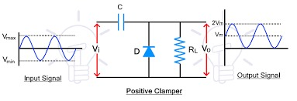
Example

Slide 6

Negative Clampers
On the other hand, if the circuit pushes the signal downwards then the circuit is said to be a negative clamper. When the signal is pushed downwards, the positive peak of the signal meets the zero level.

Slide 7
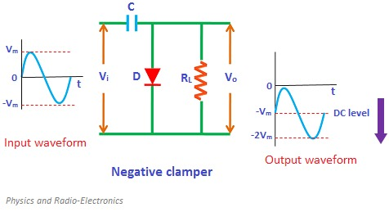

Slide 8
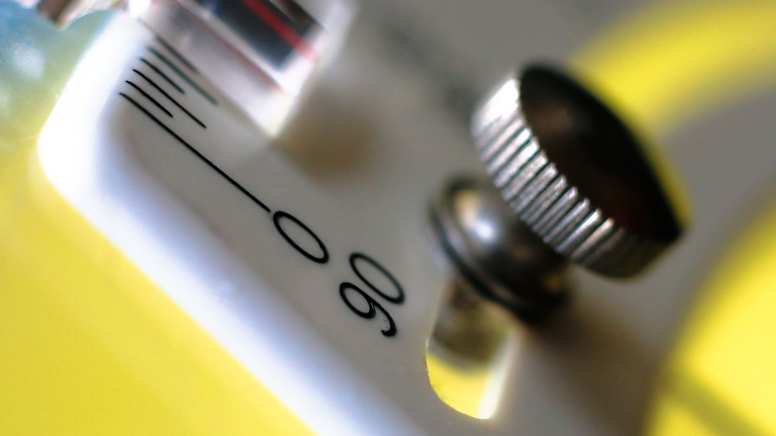
When the input supply voltage becomes greater than the battery voltage then the diode stops allowing electric current through it because the diode becomes reverse biased.
Positive Clampers with Positive Bias

Slide 9
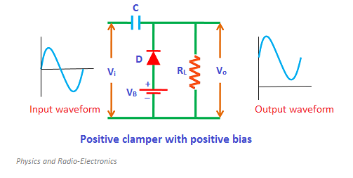

Slide 10

When the input supply voltage becomes greater than the battery voltage, the diode is forward biased by the input supply voltage and hence allows electric current through it.
Positive Clampers with Negative Bias

Slide 11
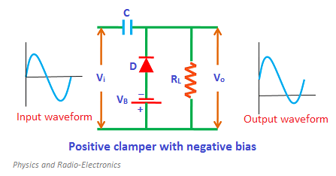

Slide 12
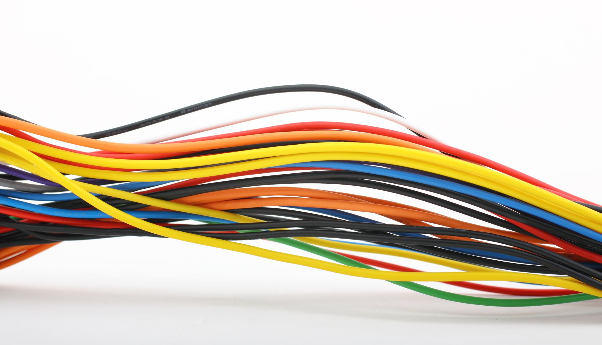
When the input supply voltage becomes greater than the battery voltage, the diode is forward biased by the input supply voltage and hence allows electric current through it
Negative Clampers with Positive Bias

Slide 13
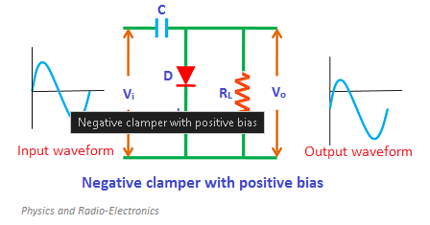

Slide 14
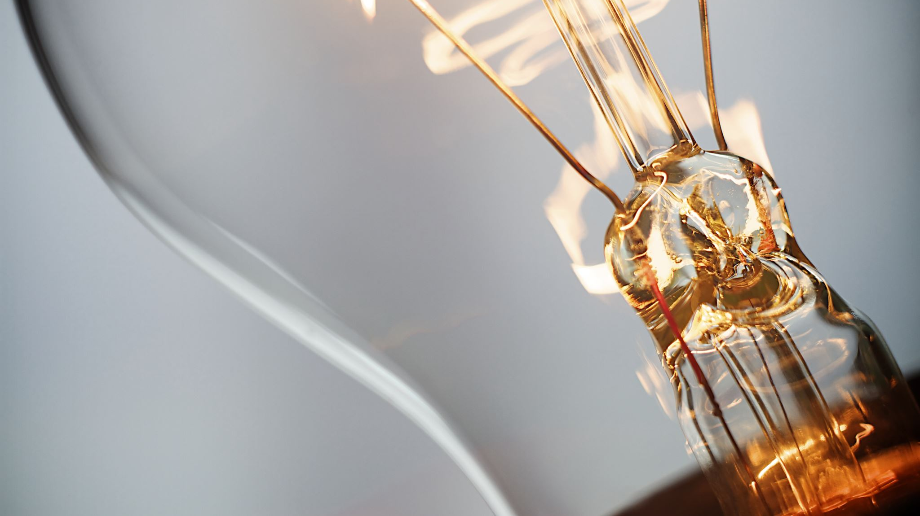
During the positive half cycle, the diode is forward biased by both input supply voltage and battery voltage
Negative Clampers with Negative Bias

Slide 15
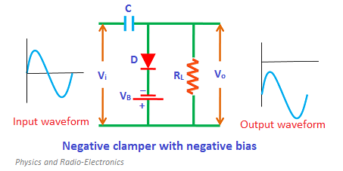

Slide 16
Applications
It is used as a voltage multiplier.
It is used for improving the reverse recovery time.
It is used for removing the distortion in the signal.
It is also used as test equipment.

Slide 17

Thank You

